Slide 1

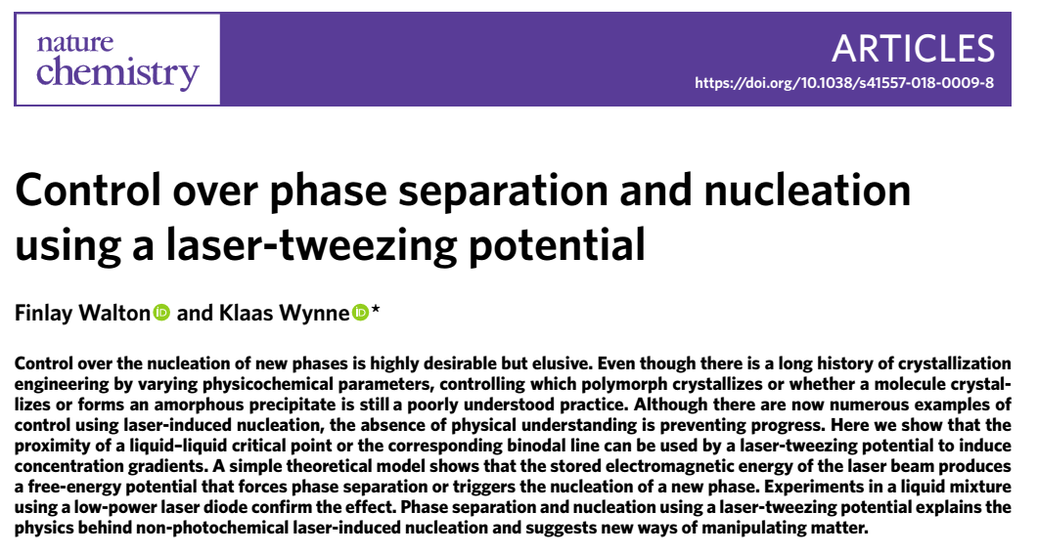

Andrew Voyles
06 April 2018
UiO NEP Journal Club

Slide 2
Background
Crystallization is one of the “voodoo” arts of Chemistry
Massively sensitive multi-parameter phase transition:
Solvent (and a near-infinite choice of mixtures of solvents)
Temperature
Heating and cooling rates
Concentration
Stirring rate
Size and material of the vessel
Traces of water or other impurities
06 Apr 2018| A S Voyles

Slide 3
Background
Thermodynamics of solid ←→ liquid phase transitions are extremely complex, and not fully understood
No a priori models for predicting melting points exist!
Along with poorly-understood crystallization, this indicates a lack of understanding of transitions to (or out of) an ordered solid phase
This has major consequences for separations processes
Protein crystallography
Azeotropic cracking
Pharmaceutical purification
06 Apr 2018| A S Voyles

Slide 4
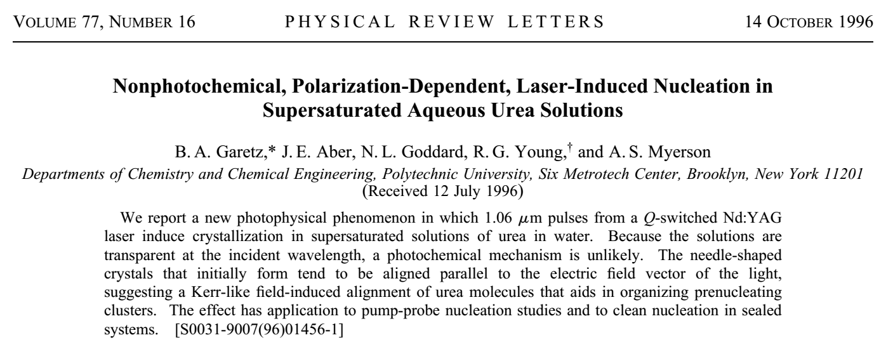
Background
Discovered in 1996 that shining a small, bright laser beam into a concentrated solution can induce crystallization
Long-standing disagreement over how that works
Originally proposed to be example of Kerr-like Effect
06 Apr 2018| A S Voyles

Slide 5





Kerr Effect
Enhancement of media refractive index due to susceptibility to external electric field
In the case of a laser, the monochromatic wave acts as this field:
Leads to a laser intensity-dependent refractive index
06 Apr 2018| A S Voyles

Slide 6
Background
Evidence for Kerr-like effects in crystallization have been inconsistent and inconclusive
Present work asserts that laser-induced crystallization is due not to polarization effects, but by the formation of concentration/depletion zones
Crystallization separations typically done on saturated/supersaturated solutions
In this solution, solid crystal phase is the thermodynamic ground state
Phase transition still has energetic / potential barrier, typically overcome by addition of nucleation seed / external perturbation
06 Apr 2018| A S Voyles

Slide 7


Background
Authors propose that formation of concentration/depletion zones is capable of inducing crystallization in solutions near transition
Application as separation technique for highly miscible solutions
Concentrating one component together, and “skimming” it off
Not unlike selectively separating cream from coffee
Or rosiner from boller….
Paper deals with easier test case – miscible liquid/liquid solution of nitrobenzene / decane
06 Apr 2018| A S Voyles

Slide 8

Mixing Model
Binary nitrobenzene / decane solution modeled as regular solution (non-ideal)
Free energy of system is function of mole fractional composition x_{i}
Laser adds additional enthalpy term for the added electromagnetic energy
Lowers system free energy, “trapping” highest n component
06 Apr 2018| A S Voyles

Slide 9
Methods
Used 785 nm (near-infrared) laser to stimulate a ~12um thick sample
Laser power ranged 0 < P < 200 mW
Sample mixture held on dual-cryo-cooled stage of microscope
Temperature held 280 – 300 K, to maintain stable mixture (miscible solution)
Impact of laser-induced phase separation (LIPS) verified by:
Phase-contrast microscopy – converts optical path length → intensity, used to “image” refractive index
Fluorescence imaging – methylene blue dye added to mixture
Dye’s fluorescence quenched ∝ nitrobenzene concentration
Visual highlighting of phase composition
06 Apr 2018| A S Voyles

Slide 10
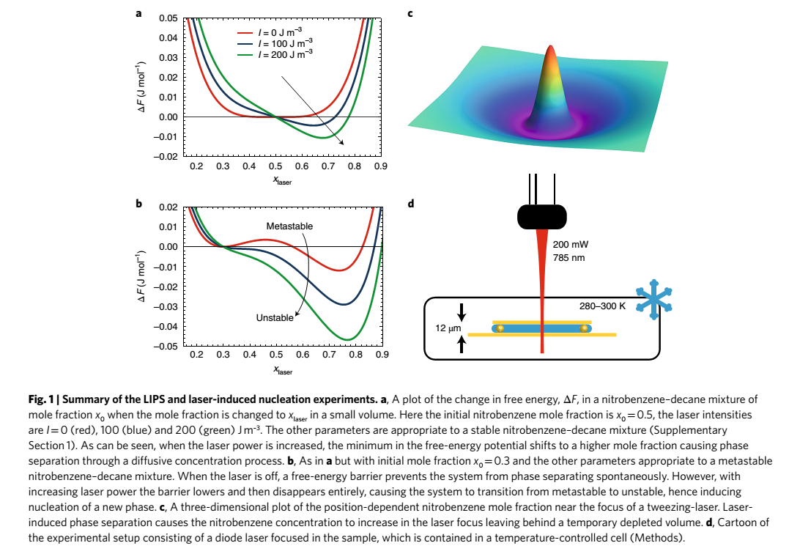
Methods
Nitrobenzene-rich fraction w/ 4.5um FWHM, depletion region w/ ~10 um radius
Stable → unstable phase transition induced by increasing laser power
06 Apr 2018| A S Voyles

Slide 11
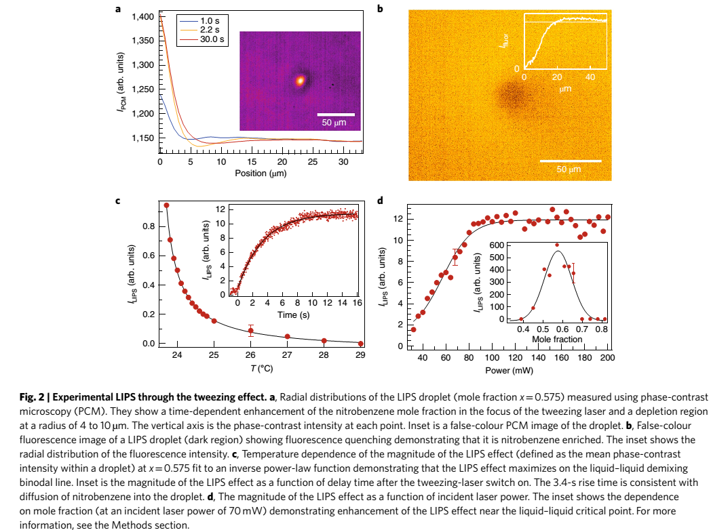
Methods
Evolution of phase transition is time-dependent. Established within ~1s, stabilizes around 30s
Fluorescence confirms “tweezed” droplet is nitrobenzene-rich component
Phase separation enhanced by lower-temperatures → dampening of diffusion, which counteracts LIPS
06 Apr 2018| A S Voyles

Slide 12
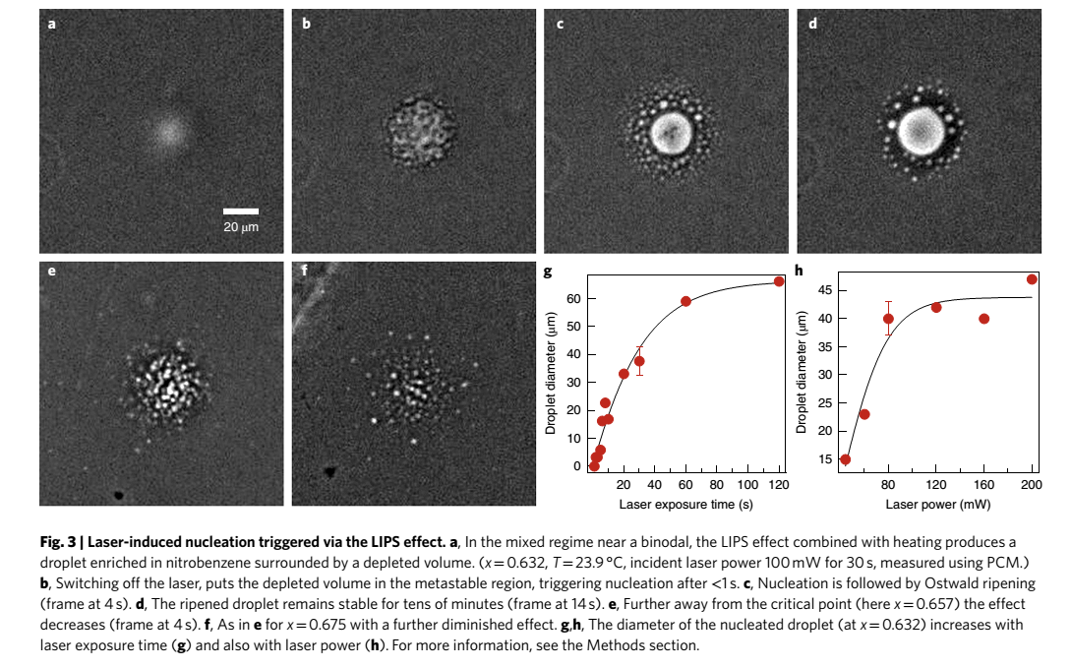
Laser on: potential induction
Laser off: temperature drops, crashing mixture below bimodal
Nucleation induced!
Stable after ~30s, remains stable for 10’s of minutes
Methods
06 Apr 2018| A S Voyles

Slide 13
Conclusions
“This is a generic effect that does not only apply to poorly mixing liquids but to any mixture or solution. However, the ease with which the laser-tweezing potential can initiate phase separation is enhanced near a liquid–liquid demixing critical point or binodal line. Phase manipulation and nucleation can be induced with a straightforward low-power laser diode. This suggests that this effect can be used to control matter in a range of practical applications.”
Mostly applicable for solutions already close to critical / phase transition point!
Way to “reverse” entropy and cause phase separations, and isn’t that energy intensive!
Interesting potential applications for difficult separations of exotic/small-scale systems
Isotopic separation?
06 Apr 2018| A S Voyles

